Slide 1
Processes Communication

Slide 2
Interprocess Communication
Processes within a system may be independent or cooperating
Cooperating process can affect or be affected by other processes, including sharing data
Reasons for cooperating processes:
Information sharing
Computation speedup
Modularity
Convenience
Cooperating processes need interprocess communication (IPC)
Two models of IPC
Shared memory
Message passing

Slide 3
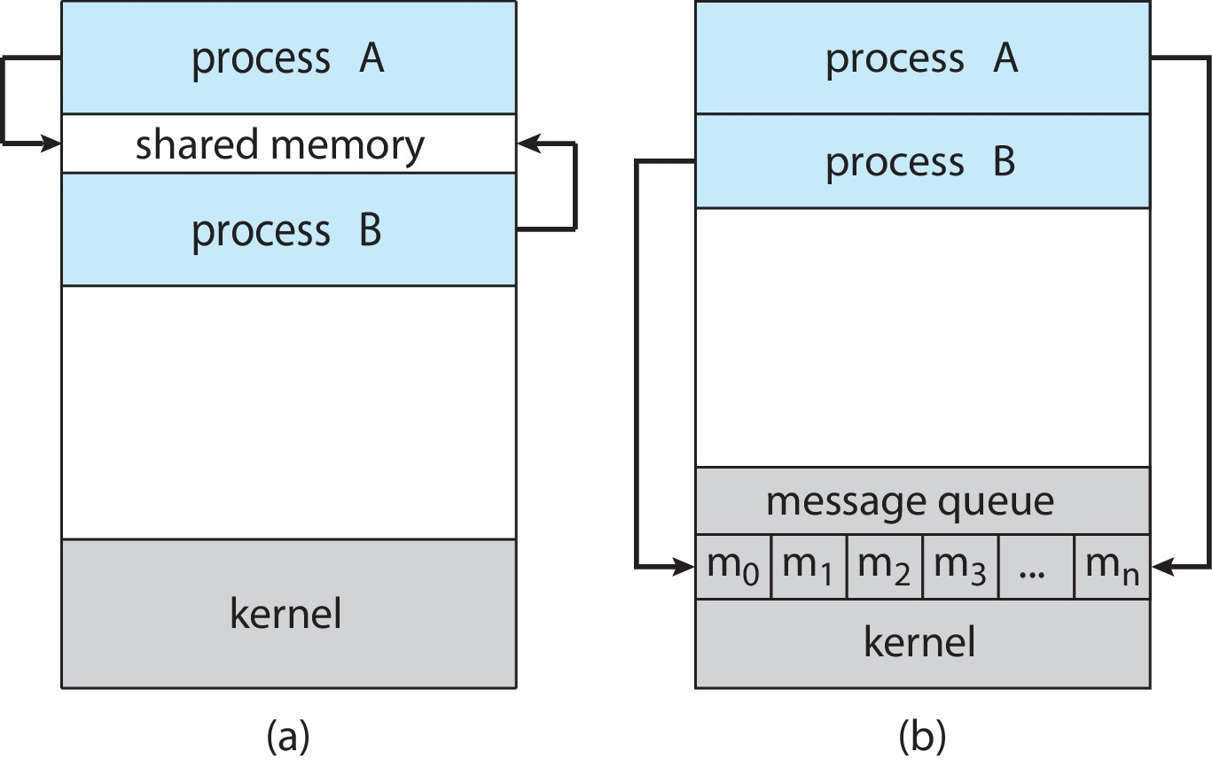
Communications Models
(a) Shared memory. (b) Message passing.

Slide 4
IPC – Message Passing
Processes communicate with each other without resorting to shared variables
IPC facility provides two operations:
send(message)
receive(message)
The message size is either fixed or variable

Slide 5
Message Passing (Cont.)
If processes P and Q wish to communicate, they need to:
Establish a communication link between them
Exchange messages via send/receive
Implementation issues:
How are links established?
Can a link be associated with more than two processes?
How many links can there be between every pair of communicating processes?
What is the capacity of a link?
Is the size of a message that the link can accommodate fixed or variable?
Is a link unidirectional or bi-directional?

Slide 6
Implementation of Communication Link
Physical:
Shared memory
Hardware bus
Network
Logical:
Direct or indirect
Synchronous or asynchronous
Automatic or explicit buffering

Slide 7
Direct Communication
Processes must name each other explicitly:
send (P, message) – send a message to process P
receive(Q, message) – receive a message from process Q
Properties of communication link
Links are established automatically
A link is associated with exactly one pair of communicating processes
Between each pair there exists exactly one link
The link may be unidirectional, but is usually bi-directional

Slide 8
Indirect Communication
Messages are directed and received from mailboxes (also referred to as ports)
Each mailbox has a unique id
Processes can communicate only if they share a mailbox
Properties of communication link
Link established only if processes share a common mailbox
A link may be associated with many processes
Each pair of processes may share several communication links
Link may be unidirectional or bi-directional

Slide 9
Indirect Communication (Cont.)
Operations
Create a new mailbox (port)
Send and receive messages through mailbox
Delete a mailbox
Primitives are defined as:
send(A, message) – send a message to mailbox A
receive(A, message) – receive a message from mailbox A

Slide 10
Indirect Communication (Cont.)
Mailbox sharing
P₁, P₂, and P₃ share mailbox A
P₁, sends; P₂ and P₃ receive
Who gets the message?
Solutions
Allow a link to be associated with at most two processes
Allow only one process at a time to execute a receive operation
Allow the system to select arbitrarily the receiver. Sender is notified who the receiver was.

Slide 11
Synchronization
Message passing may be either blocking or non-blocking
Blocking is considered synchronous
Blocking send -- the sender is blocked until the message is received
Blocking receive -- the receiver is blocked until a message is available
Non-blocking is considered asynchronous
Non-blocking send -- the sender sends the message and continue
Non-blocking receive -- the receiver receives:
A valid message, or
Null message
Different combinations possible
If both send and receive are blocking, we have a rendezvous

Slide 12
Buffering
Queue of messages attached to the link.
Implemented in one of three ways
1. Zero capacity – no messages are queued on a link. Sender must wait for receiver (rendezvous)
2. Bounded capacity – finite length of n messages Sender must wait if link full
3. Unbounded capacity – infinite length Sender never waits

Slide 13
Communications in Client-Server Systems
Sockets
Remote Procedure Calls

Slide 14
Sockets
A socket is defined as an endpoint for communication
Concatenation of IP address and port – a number included at start of message packet to differentiate network services on a host
The socket 161.25.19.8:1625 refers to port 1625 on host 161.25.19.8
Communication consists between a pair of sockets
All ports below 1024 are well known, used for standard services
Special IP address 127.0.0.1 (loopback) to refer to system on which process is running

Slide 15
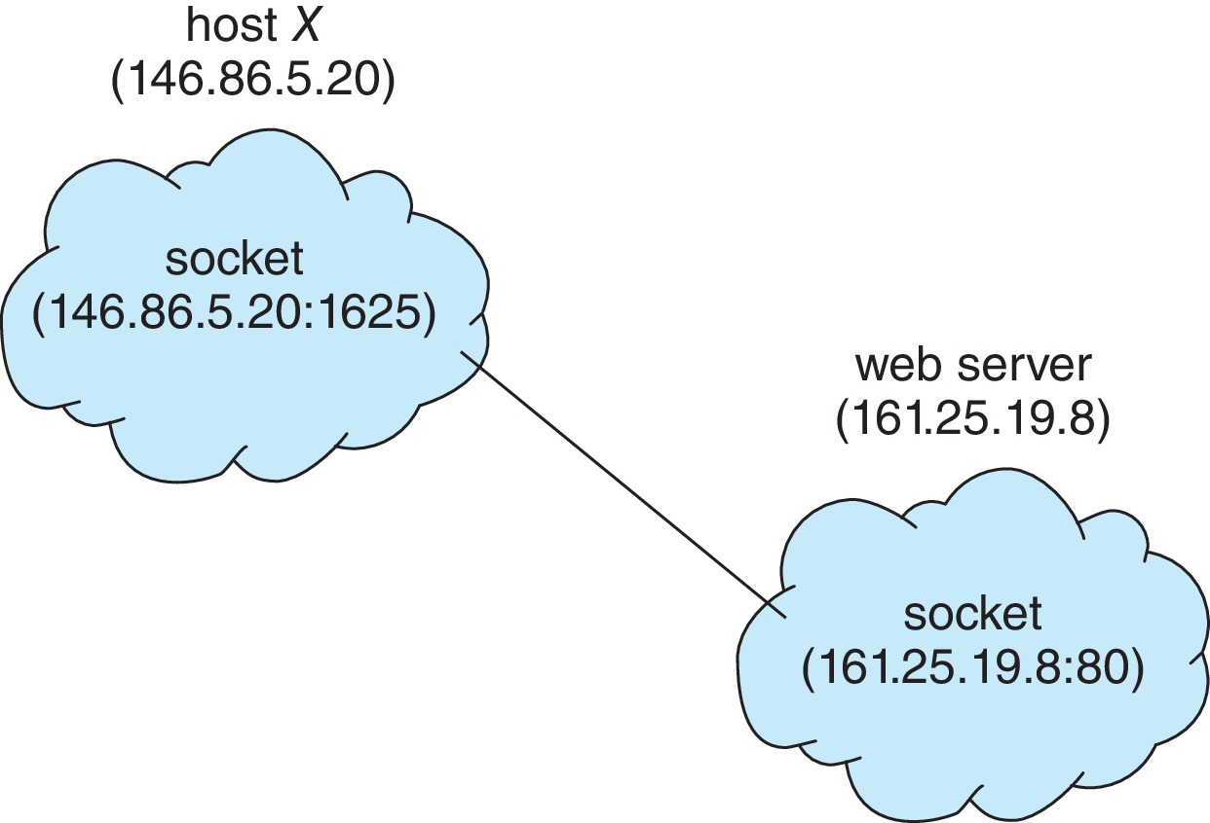
Socket Communication

Slide 16
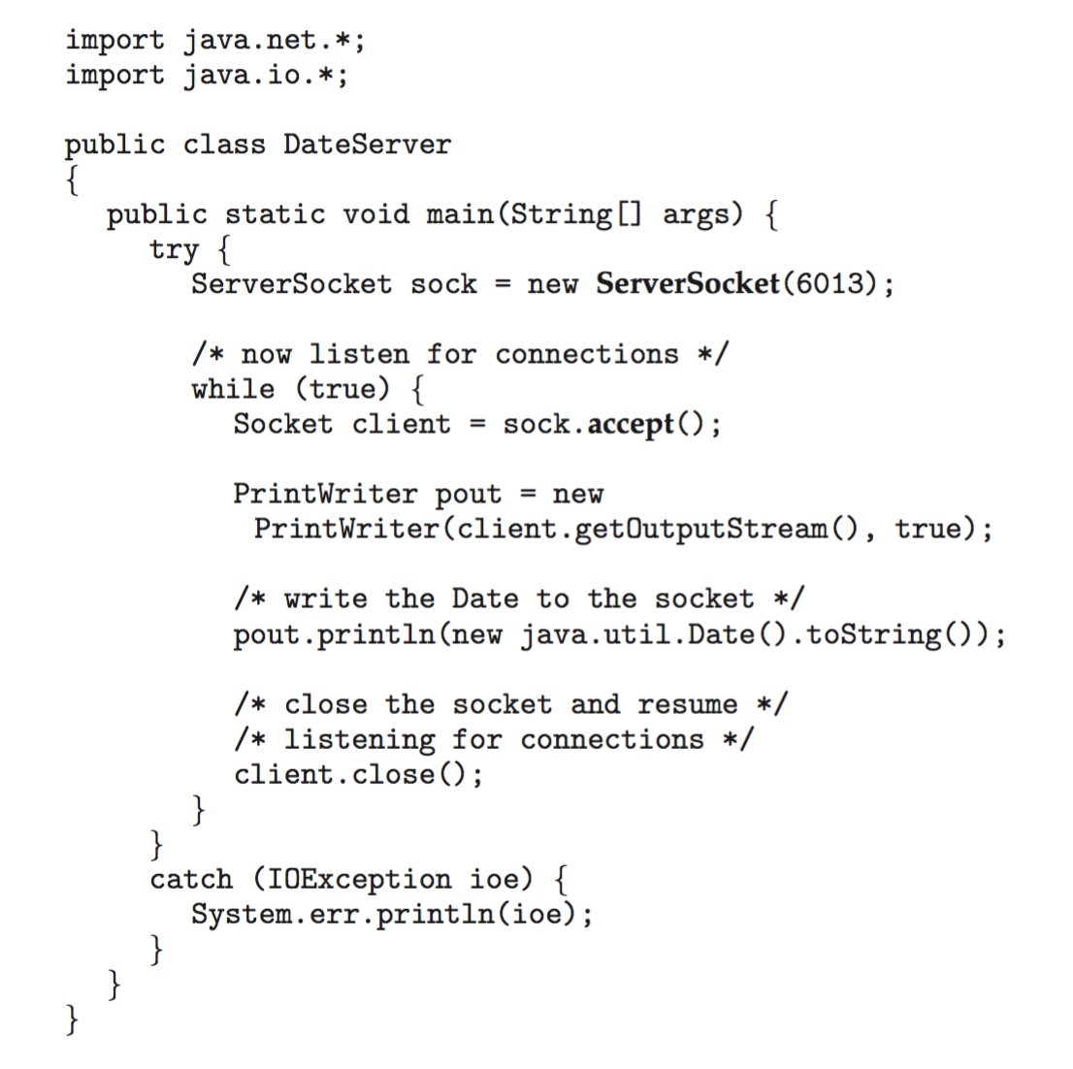
Sockets in Java
Three types of sockets
Connection-oriented (TCP)
Connectionless (UDP)
MulticastSocket class– data can be sent to multiple recipients
Consider this “Date” server in Java:

Slide 17
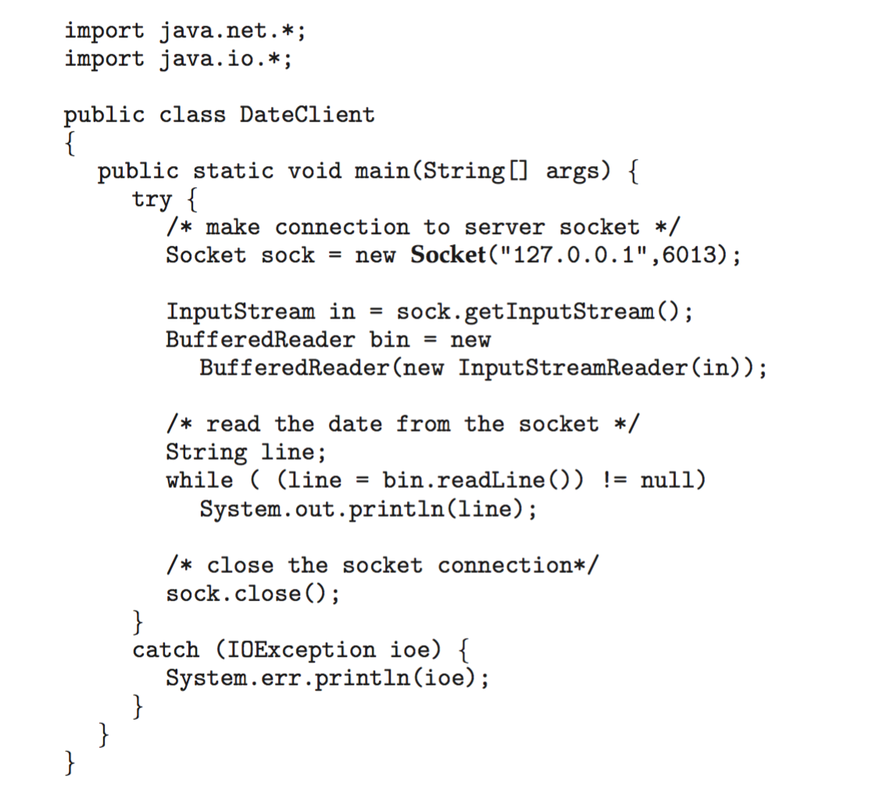
Sockets in Java
The equivalent Date client

Slide 18
Remote Procedure Calls
Remote procedure call (RPC) abstracts procedure calls between processes on networked systems
Again uses ports for service differentiation
Stubs – client-side proxy for the actual procedure on the server
The client-side stub locates the server and marshalls the parameters
The server-side stub receives this message, unpacks the marshalled parameters, and performs the procedure on the server
On Windows, stub code compile from specification written in Microsoft Interface Definition Language (MIDL)

Slide 19
Remote Procedure Calls (Cont.)
Data representation handled via External Data Representation (XDL) format to account for different architectures
Big-endian and little-endian
Remote communication has more failure scenarios than local
Messages can be delivered exactly once rather than at most once
OS typically provides a rendezvous (or matchmaker) service to connect client and server

Slide 20
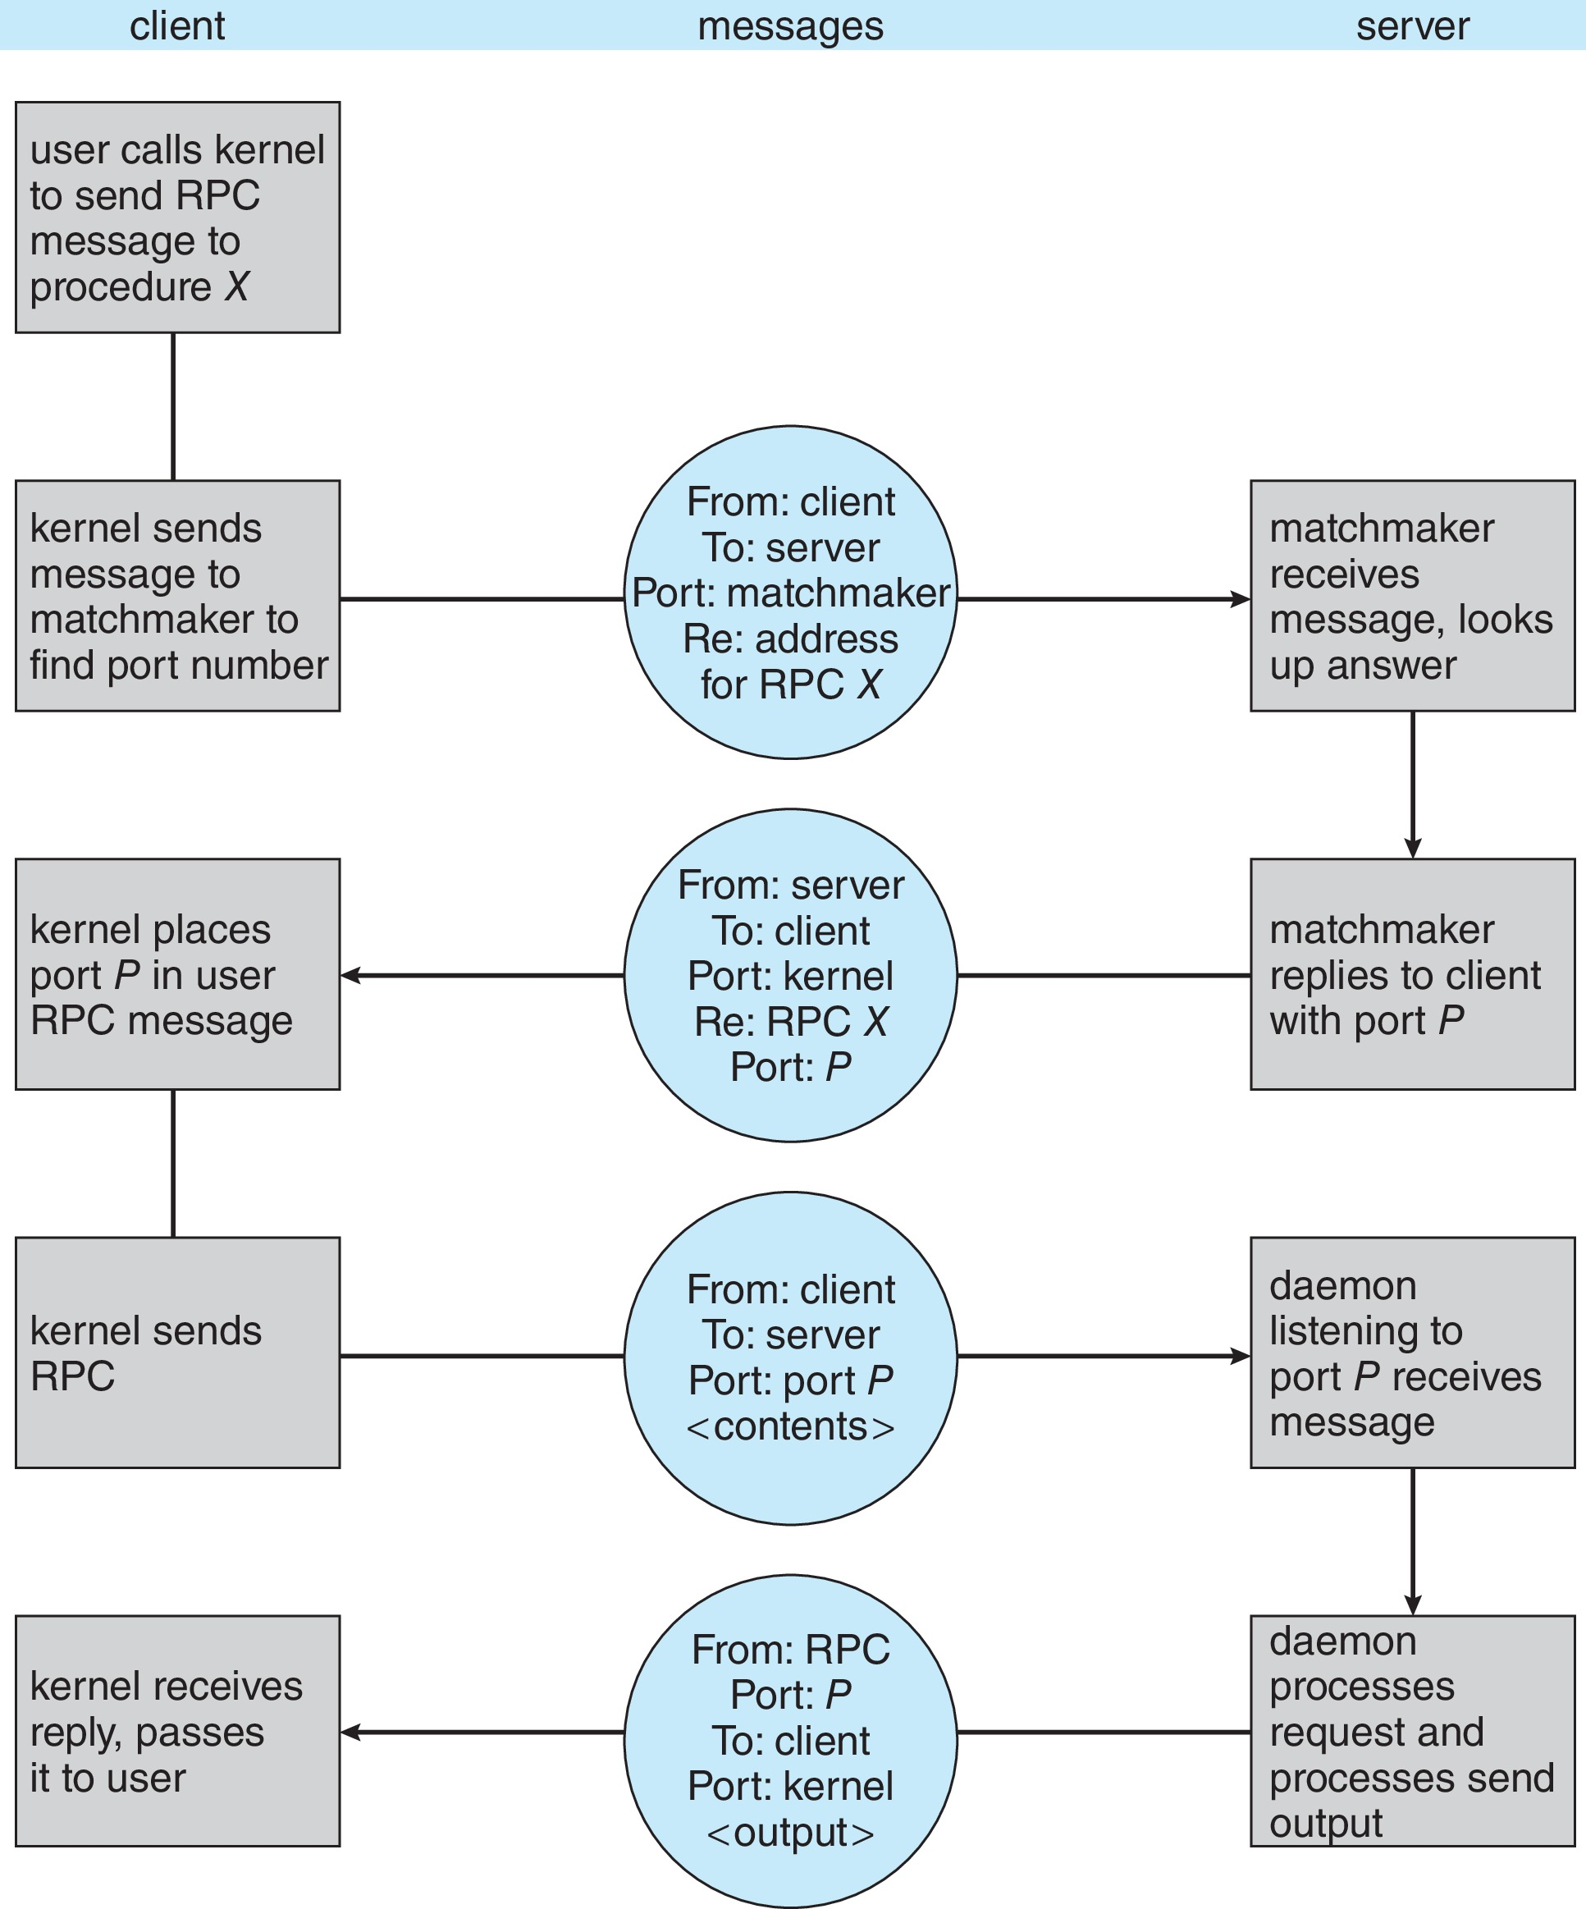
Execution of RPC

Slide 21
End of Chapter 3

